Slide 1


Deep Learning Project Presentation
Image Classification using CNN (LFW Dataset)

Slide 2
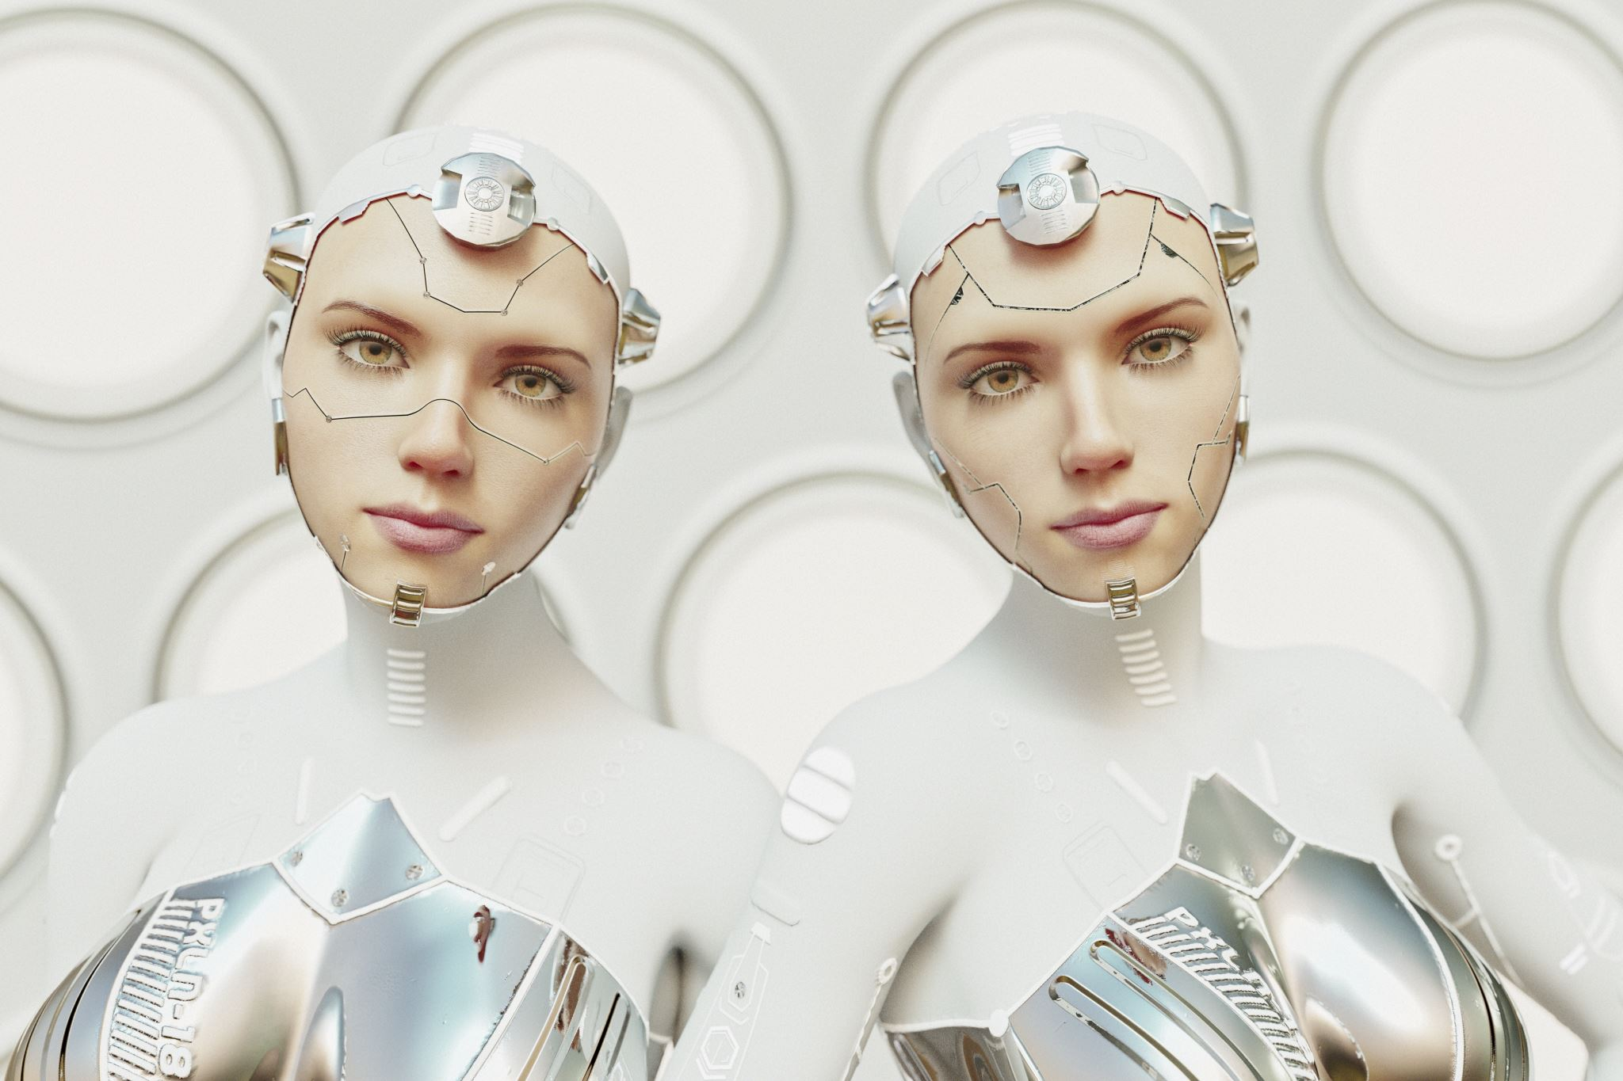
Project Overview
This project focuses on image classification using deep learning techniques.
Dataset: Labeled Faces in the Wild (LFW).
Models Used: Custom CNN.
Tools: PyTorch, Matplotlib, Grad-CAM, Sklearn.

Slide 3
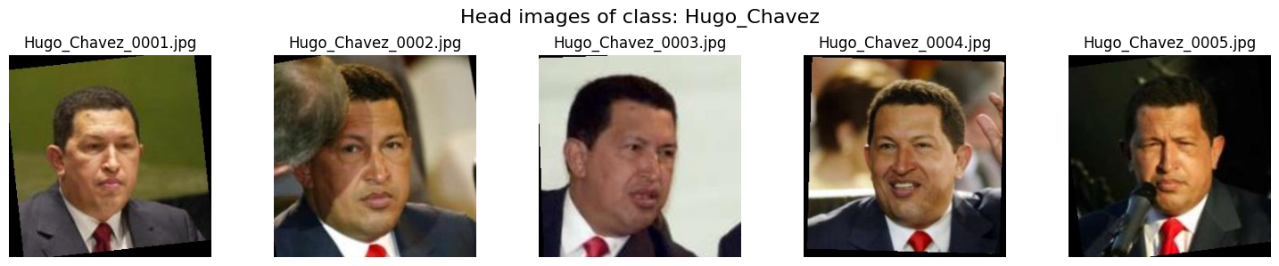
Dataset & Preprocessing
- LFW dataset from Kaggle (~13,000 face images)
- Selected top 10 classes with ≥10 images
- Resized to 128x128, Normalized, Augmented
(flip, rotate, color jitter)
- Split into 70% training and 30% validation

Slide 4
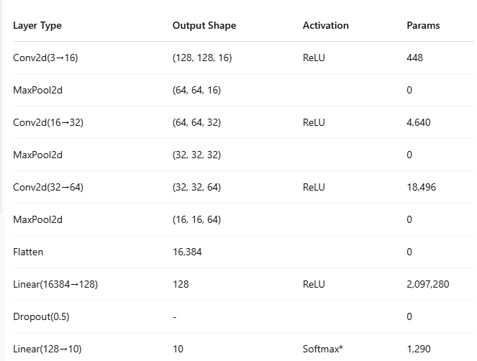
Model Architectures
3 Convolutional layers
ReLU activation after each convolution
Max pooling for spatial downsampling after each layer

Slide 5
Training Configuration
- Optimizer: Adam
- Loss Function: CrossEntropyLoss
- Epochs: 30
- Batch Sizes: 32, 64, 128
- Learning Rates: 0.01, 0.1, 0.001, 0.0001

Slide 6
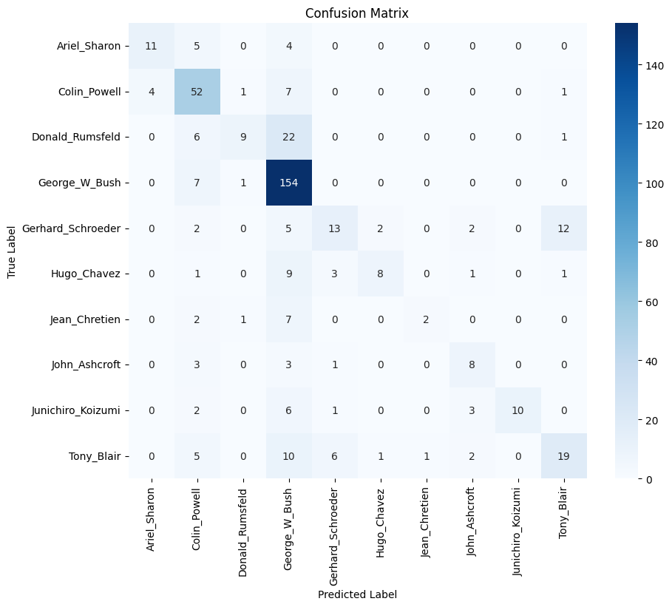
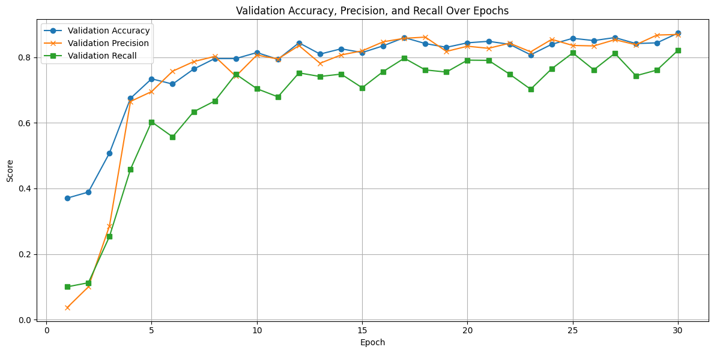
Graph with different learning rate

Slide 7
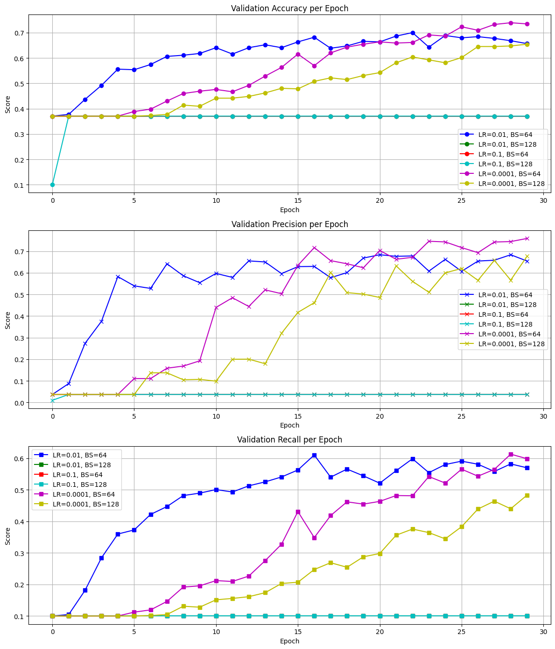

Slide 8
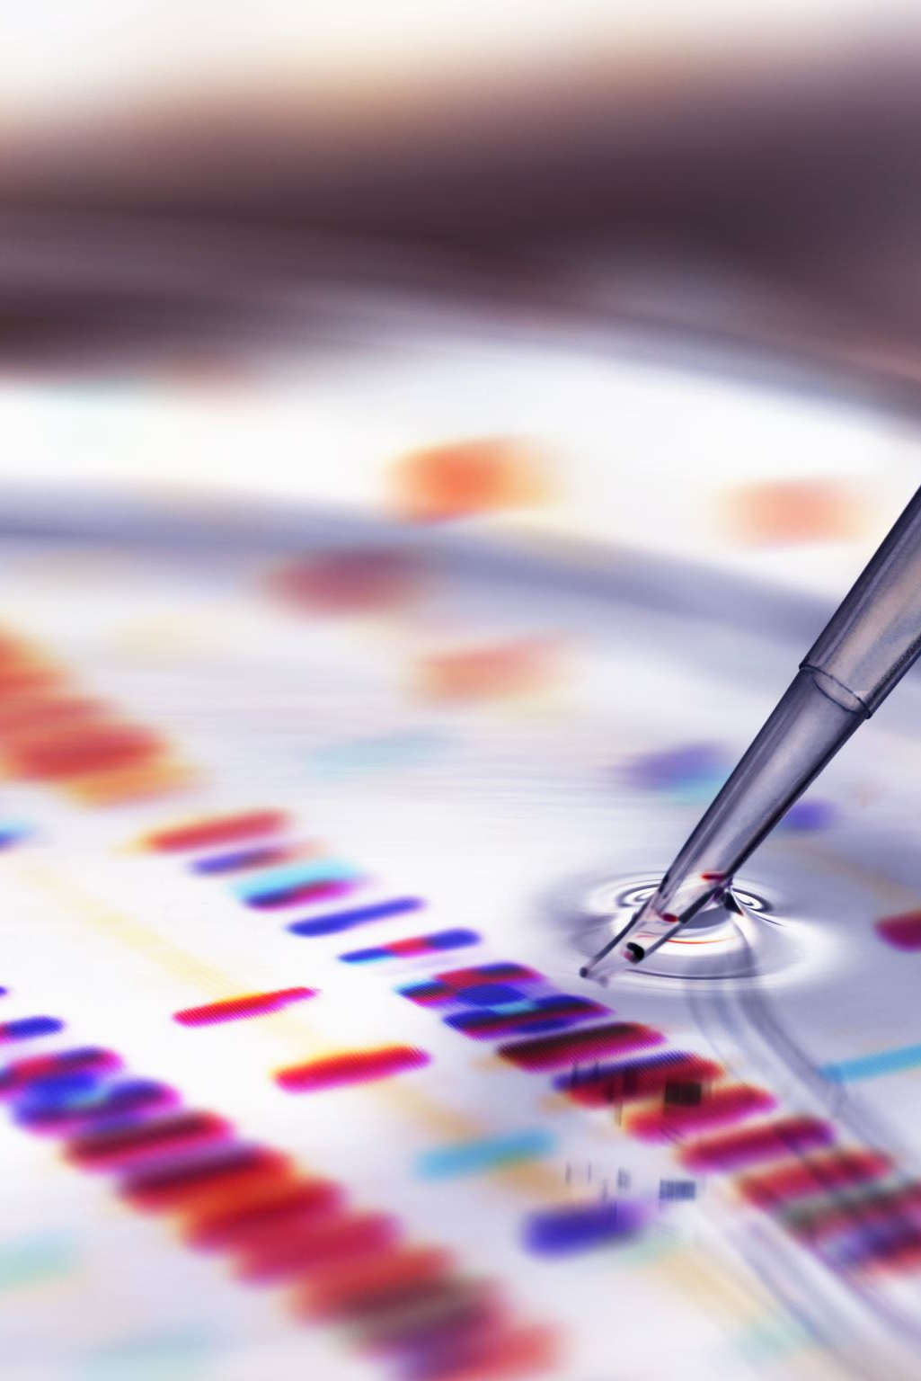
Evaluation Metrics
- Accuracy
- Precision (macro average)
- Recall (macro average)
- Confusion Matrix
- Misclassified Image Review

Slide 9
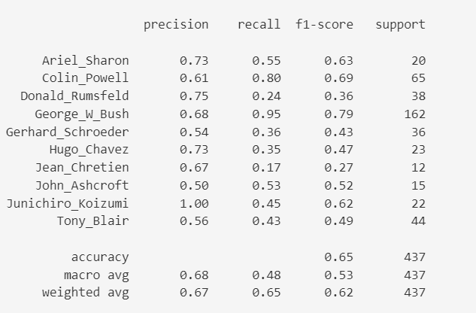
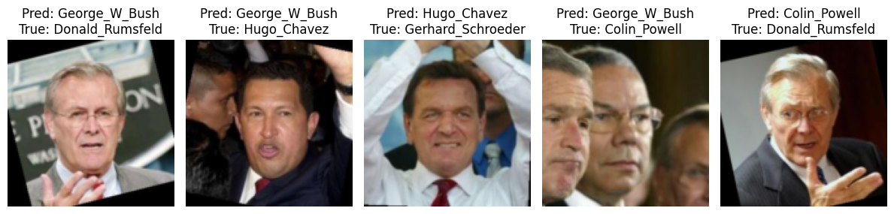
Misclassified Image Review

Slide 10

Grad-CAM Visualizations
target_layer.register_forward_hook(...)
target_layer.register_backward_hook(...)
- target_layer = model.features[6]
- Focused on facial regions (eyes, mouth, nose)
- Helped validate model's learning behavior

Slide 11
Key Findings & Future Work
Custom CNN
Data augmentation improved generalization
Grad-CAM provided meaningful insights
Improvements:
Add early stopping & learning rate scheduling
Try deeper models (ResNet50, EfficientNet)
Include F1-score and AUC for evaluation

Slide 12
Presentation Summary
Objective:
- Build a deep learning model for face image classification using the LFW dataset.
Key Outcomes:
- Custom CNN and evaluated.
- ResNet18 outperformed custom model in accuracy and robustness.
- Grad-CAM provided model interpretability by highlighting facial features.
Lessons Learned:
- Importance of data preprocessing and augmentation.
- Transfer learning significantly boosts performance on small datasets.
- Visualization tools like Grad-CAM are crucial for trust and insight.
Challenges:
- Handling class imbalance in dataset.
- Hyperparameter tuning and overfitting control.
- Integrating Grad-CAM with modified CNN structure.

Slide 13

References
LFW Dataset (Kaggle): kaggle.com/datasets/jessicali9530/lfw-dataset
Tools & Frameworks
PyTorch Documentation: pytorch.org
torchvision : pytorch.org/vision
scikit-learn Metrics: scikit-learn.org
Matplotlib Library: matplotlib.org

